Slide 1

Lesson 3: SCT General Packages
In this lesson you will learn how to use SCT in general packages.
Here are the lessons to be covered:
Overview of Studio Customization Toolkit (SCT)
SCT in Java Program Objects (JPOs)
3. SCT General Packages
4. SCT and Commonly Used Classes

Slide 2
ENOVIA Business Process Services (BPS) JARs
ENOVIA Live Collaboration Business Process Services (BPS) installs the Application Exchange Framework (AEF) which is the foundation for all ENOVIA Business Process Applications (Centrals) and Accelerators
It installs the prerequisite data model, the UI Configurable Components (and other JSPs) and additional Java classes that are built on top of the ENOVIA Studio Customization Toolkit (eMatrixServletRMI.jar )
These additional Java classes installed by the AEF reside in the framework.jar & common.jar. plmprovider.jar and kcservlet.jar
The framework jar file contains the base classes; DomainObject and DomainRelationship, as well as several interfaces and classes that are needed to support these base classes. This jar file also contains a number of utility classes.
The framework.jar file also contains custom tags that make up our custom tag library, and classes that wrap the dynamic UI components (often referred to as the UI Beans)

Slide 3
com.matrixone.apps.framework.ui (framework.jar Package)
The UI Java classes that are used as Java Beans for build up GUI:
Forms, Tables, Portals and other UI Administrative objects
Web Reports, Rendering, Pagination utilities
These are also used by the JSP configurable components.

Slide 4
com.matrixone.apps.domain.util (framework.jar Package)
The util Java classes to manage the ENOVIA routines, such as:
String internationalization, property translation
Sending Mails, Perform MQL requests
Other Utility Classes for working with Dates, Persons, and Context

Slide 5
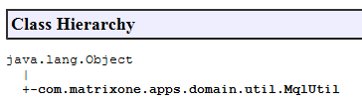
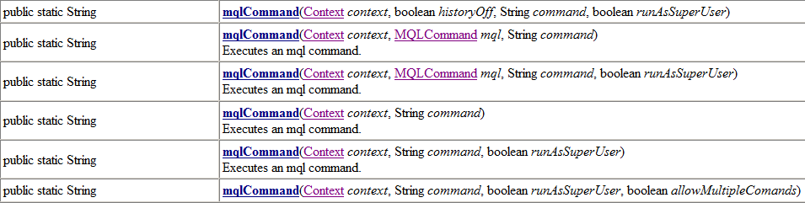
MqlUtil Class
The MqlUtil class from com.matrixone.apps.domain.util package contains static methods that can be used to execute MQL commands.
However, SCT Classes covers 99% of needs to interact with ENOVIA core. So you should use SCT classes instead.

Slide 6
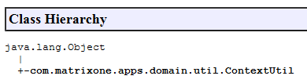
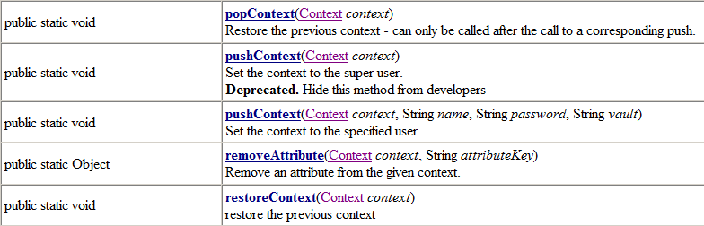
ContextUtil Class (1/2)
The ContextUtil class from com.matrixone.apps.domain.util package contains static methods for context-related activities.
Often used for switching the context inside program to other Person (usually with higher permissions).

Slide 7
ContextUtil Class (2/2)
The ContextUtil class methods are also used to handle the transaction within your programs:
try
{
ContextUtil.startTransaction(context, false); // Start transaction at the start of the try block
...
ContextUtil.commitTransaction(context); // Commit transaction at the end of the try block
} catch (Exception ex) {
ContextUtil.abortTransaction(context); // Abort transaction inside of catch block
}

Slide 8
com.matrixone.apps.domain (framework.jar Package)
The domain Java classes (extended) for work with Business Objects and their relationships:
DomainObject class.
DomainRelationship class.
DomainConstants and DomainSymbolicConstants interfaces

Slide 9
DomainObject Class Inheritance (1/2)
DomainConstants
BusinessObject
DomainSymbolic Constants
Extends
Implements
DomainObject
Object Instance
Extends
CustomTypeClass
Object Instance
Object Instance

Slide 10
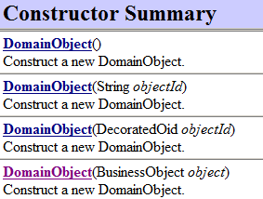
DomainObject Class Inheritance (2/2)
Wherever you can use BusinessObject class, use DomainObject class instead (if developing an ENOVIA application on top of BPS).
Because of inheritance, DomainObject class contains all methods, provided by BusinessObject class plus general Constants, which can be used as selectables.
If SCT method returns BusinessObject translate it into DomainObject using DomainObject constructor.

Slide 11


DomainObject Constructors
Default (empty) constructor (used to create new object in ENOVIA Database):
Constructor with Object ID:
Constructor from BusinessObject:

Slide 12
DomainObject Methods (1/4)
To get the Business object basics, use the following methods:
getObjectId(context)
getInfo(context, "type")
getInfo(context, "name")
getInfo(context, "revision")
getPolicy(context); / getInfo(context, “policy")
To read multiple values use getInfo, which returns Map object:
getInfo(context, objectSelects)

Slide 13
DomainObject Methods (2/4)
To change the Business object basics, use the following methods:
setName(context, "New Name")
setVault(context, "New Vault")
setPolicy(context, "New Policy")
If multiple changes required, use the following method to reduce database calls:
change(context, “New Type”, “New Name”, “New Revision”, “New Vault”, “New Policy”)

Slide 14
DomainObject Methods (3/4)
To get the other Business object details, use the following methods:
getDescription(context)
getOwner(context)
getModified(context)
getAttributeValue(context, "Attribute Name")
To set them:
setDescription(context, "New Description")
…
setAttributeValue(context, "Attribute Name", "Attribute Value")

Slide 15
DomainObject Methods (4/4)
Other commonly used methods:
getRelatedObjects(…)
addRelatedObjects(…)
findObjects(…)
Using DomainObject class and its methods, you can do any kind of manipulations with Business Objects, like in ENOVIA Matrix Navigator or MQL.

Slide 16
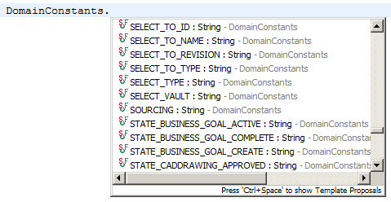
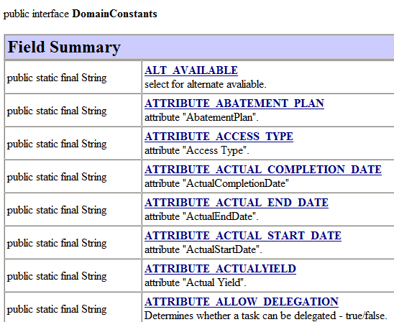
DomainConstants Interface (1/2)
DomainObject class implements DomainConstants interface, which contains BPS administrative object names and their selectable(s), defined as String constants.

Slide 17
DomainConstants Interface (2/2)
Avoid using the DomainConstants interface directly:
Use DomainObject class instead:
Or, if created method belongs to class, derived from DomainObject class, you can use constants directly:

Slide 18
Getting Business Object Details with BPS DomainObject Class
.The DomainObject class that resides in framework.jar (and has been derived from the BusinessObject class that resides in eMatrixServletRMI.jar) provides the getInfo() method that can be used to get hold of any Business Object details.
Example 1:
Example 2:
DomainObject dom = new DomainObject (objId);
System.out.println ("Vault = " + dom.getInfo(context,"vault"));
System.out.println ("Owner = " + dom.getInfo(context,"owner"));
DomainObject dom = new DomainObject (objId);
System.out.println ("Attribute[Cost] = " + dom.getInfo(context,"attribute[Cost]"));
Domain.getInfo() accepts any valid MQL Business Object selectables (in MQL Command Editor use print bus selectable; to find all possible selectables for Business Objects)
4-23

Slide 19
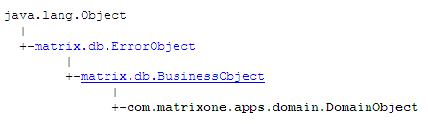
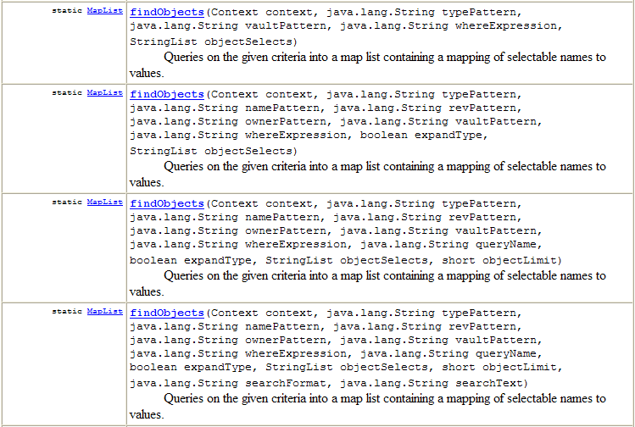
DomainObject.findObjects() Methods
These DomainObject.findObjects() methods allow you to run queries much easier than using the Query.getIterator() method.
Overloaded findObjects() methods in DomainObject class:
4-27

Slide 20
Usage of findObjects()
MapList objectList = new MapList(); StringList selectlist = new StringList(); selectlist.addElement("current"); try { MapList mpList = DomainObject.findObjects (context,"Personal Computer","*","",selectList); Iterator it = mpList.iterator(); while(it.hasNext()) { Map map=(Map)it.next();
System.out.println(“Current = " + map.get("current"));
} } catch (Exception ex) { System.out.println("Error running findObjects()" + ex.getMessage()); }
4-28

Slide 21
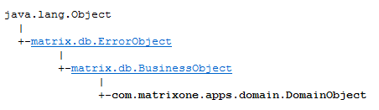
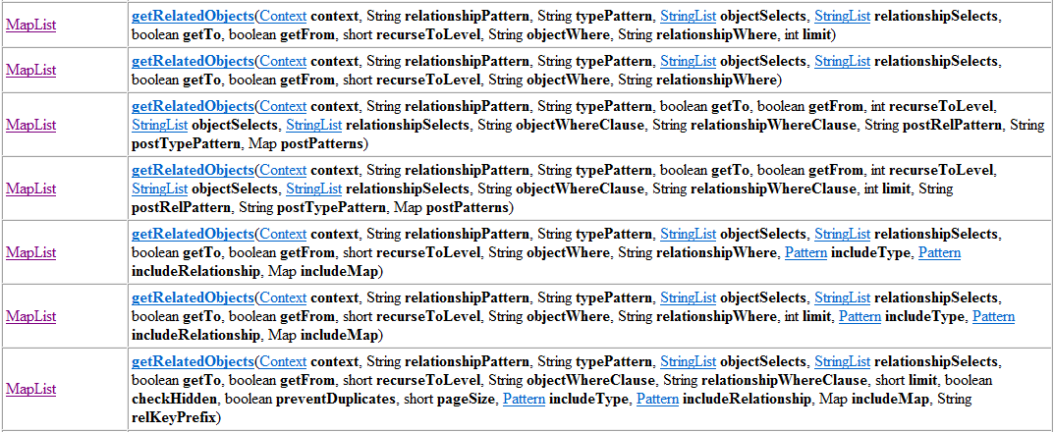
DomainObject.getRelatedObjects() Methods
These DomainObject.getRelatedObjects() methods allow you to run Queries in Java code much easier than when using the Query.getExpansionIterator() method
Overloaded getRelatedObjects() methods in DomainObject class:
4-37

Slide 22
DomainObject.getRelatedObjects() Methods
StringList selectbusStmts = new StringList(); selectbusStmts.addElement("policy"); selectbusStmts.addElement("owner"); selectbusStmts.addElement("attribute[Material Category]");
StringList selectrelStmts = new StringList(); selectrelStmts.addElement("attribute[Quantity]");
// 2)Build FILTER patterns String typepattern = "*"; String relpattern = "*"; //GET STARTING BUSINESS OBJECT DomainObject dom = new DomainObject(request.getParameter("busId")); try { MapList mpl = dom.getRelatedObjects(context, relpattern, typepattern, selectbusStmts, selectrelStmts, false, true, (short)1, "", "");
Iterator it = mpList.iterator();
while(it.hasNext()) {
Map map=(Map)it.next();

Slide 23
DomainObject.getRelatedObjects() Methods
//DISPLAY RELATIONSHIP AND BUSINESS OBJECT SELECTABLES System.out.println("Policy: " + map.get("policy"));
System.out.println("Owner: " + map.get("owner")); System.out.println("Attribute[Material Category]: " + map.get("attribute[Material Category]"));
System.out.println("Attribute[Quantity]: " + map.get("attribute[Quantity]"));
}
catch (Exception ex)
{ System.out.println("Error running getRelatedObjects()" + ex.getMessage());
}
4-39

Slide 24
DomainObject.getAttributeMap() Method
BusinessObject bo = new BusinessObject(objId);
DomainObject dom = new DomainObject(bo);
Map mp = dom.getAttributeMap(context);
Iterator attItr = mp.entrySet().iterator();
while (attItr.hasNext()) { Map.Entry thisAtt = (Map.Entry) attItr.next();
System.out.println(“Attribute Name: “ + thisAtt.getKey()); System.out.println(“ Attribute Value: “ + thisAtt.getValue());
}
4-30

Slide 25
DomainObject.setAttributeValues() method
String objId = request.getParameter("id"); DomainObject dom = new DomainObject(objId);
Map<String,String> mp = new Map<String,String>();
//Fill the Input Map mp.put("Weight","103"); mp.put("Cost","20");
//Set business object attributes dom.setAttributeValues(context, mp);
4-32

Slide 26
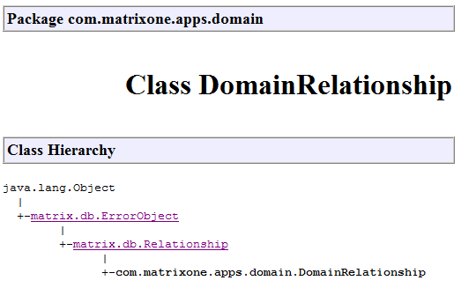
DomainRelationship Class (1/4)
com.matrixone.apps.domain.DomainRelationship is derived from matrix.db.Relationship and is for a similar purpose, but at a higher level.
Wherever you can use Relationship class, use DomainRelationship.

Slide 27
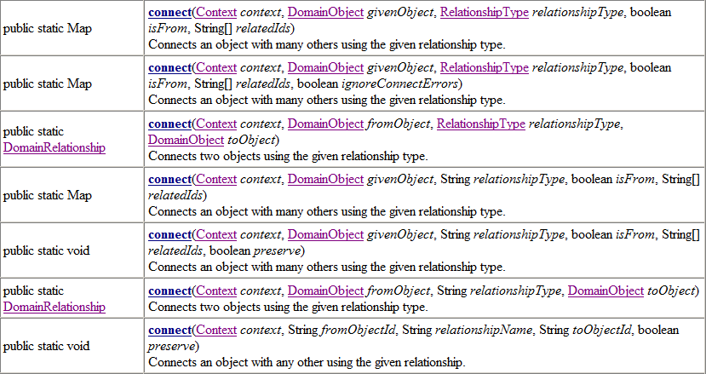
DomainRelationship Class (2/4)
DomainRelationship contains seven static connect(…) methods, therefore, that class is used:

Slide 28
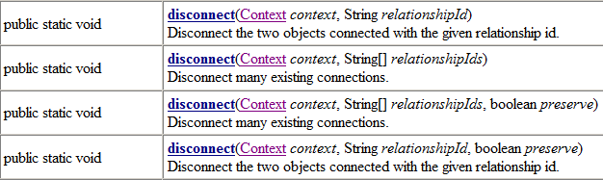
DomainRelationship Class (3/4)
DomainRelationship contains four static disconnect(…) methods as well:

Slide 29

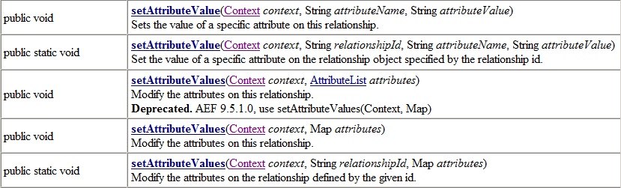
DomainRelationship Class (4/4)
Usually, DomainObject class methods and appropriate selectable(s) are enough, to get any attribute.
In case if you are instantiating DomainRelationship class, you can use getAttributeValue(…) / setAttributeValue(…) methods to work with Relationship Attributes.

Slide 30
Customizing the OOTB JSPs of the My ENOVIA / Webtop Applications – Custom JSP Filter (1/3)
A custom filter class is available for JEE- installations that allow requests from the My ENOVIA / Webtop Applications to check a separate directory for custom JSP pages.
This allows you to leave the original JSP pages of the My ENOVIA / Webtop Applications in the application directories untouched and put customized JSP pages in the custom directory under the application directory. For example custom ENOVIA Engineering Central pages will be found under directory /engineeringcentral/custom
If the custom JSP filter is enabled, the filter will first check if the requested page is in the custom directory. If not found in the custom directory, it will look for the page in the standard directory.
Implementing the custom JSP filter involves simple changes to the web.xml file.
By default, the Custom JSP Filter is disabled: <!-- Custom filter -->
<!-- Custom filter class
<filter>
<filter-name>CustomFilter</filter-name>
<filter-class>com.matrixone.servlet.CustomFilter</filter-class>
<init-param>
<param-name>ematrix.customDirName</param-name>
<param-value>/custom</param-value>
</init-param>
</filter>
-->
<!-- Custom filter mappings
<filter-mapping>
<filter-name>CustomFilter</filter-name>
<url-pattern>/engineeringcentral/*</url-pattern>
</filter-mapping>
-->
Remove multi-line comments and make them single-line comments
4-40

Slide 31
Customizing the OOTB JSPs of the My ENOVIA / Webtop Applications – Custom JSP Filter (2/3)
Multi-line comments have been removed and made single-line comments (Custom JSP Filter enabled) : <!-- Custom filter -->
<!-- Custom filter class -->
<filter>
<filter-name>CustomFilter</filter-name>
<filter-class>com.matrixone.servlet.CustomFilter</filter-class>
<init-param>
<param-name>ematrix.customDirName</param-name>
<param-value>/custom</param-value>
</init-param>
</filter>
<!-- Custom filter mappings -->
<filter-mapping>
<filter-name>CustomFilter</filter-name>
<url-pattern>/engineeringcentral/*</url-pattern>
</filter-mapping>
4-41

Slide 32
Customizing the OOTB JSPs of the My ENOVIA / Webtop Applications – Custom JSP Filter (3/3)
Alternatively, you can “leave” custom JSP pages in the same directory as the original directory.
You can specify a prefix naming convention for these custom pages by using the parameter ematrix.customFilePrefix in web.xml. Example: <init-param> <param-name>ematrix.customFilePrefix</param-name> <param-value>MyCustom_</param-value> </init-param>
Logic of the Custom JSP and Custom File Prefix filters:
If (ematrix.customFilePrefix is set) then look in the same directory as the requested file but look or a file with the custom prefix. For example: /engineeringcentral/MyCustom_emxpartCreatePartDialog.jsp
If the file in 1. cannot be found and if (ematrix.customDirName is set) look in the custom directory for the requested file. For example: /engineeringcentral/custom/emxpartCreatePartDialog.jsp
If the file in 1. cannot be found then look for the “original” requested file in the “original” application directory. For example: /engineeringcentral/emxpartCreatePartDialog.jsp
4-42

Slide 33
Lesson 4 : SCT and Commonly Used Classes
In this Lesson you will be introduced SCT commonly used classes and how SCT Classes covers 99% of needs to interact with ENOVIA core.
Here are the lessons to be covered:
Overview of Studio Customization Toolkit (SCT)
SCT in Java Program Objects (JPOs)
SCT General Packages
4. SCT and Commonly Used Classes

Slide 34
ENOVIA Business Process Services JARs
To promote reuse of business logic, a common jar file has been established independent of any application
The common jar file contains domain Beans that are shared by more than one application. The common jar file also contains utility classes shared by more than one application
There are strict rules on the dependencies allowed among the framework, common, and application tiers
Framework JSPs, JPOs, and Beans can only reference the framework jar files
The common components JSPs, JPOs, and Beans can only reference the common components and framework jar files
Each ENOVIA product's JSPs, JPOs, and Beans can only reference their own jar file and the common components and framework jar files.
An ENOVIA product can never reference another ENOVIA product's JAR file.

Slide 35
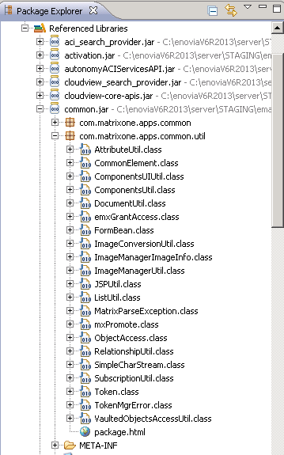
common.jar Packages
Common Components JAR-file contains two packages:
com.matrixone.apps.common : Classes to represent the BPS schema (Company, Issue, Route, etc.)
com.matrixone.apps.common.util : Classes with utility methods, to work with Subscriptions, Common Document Model, Object Access, etc

Slide 36
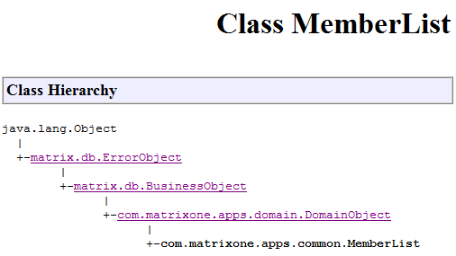
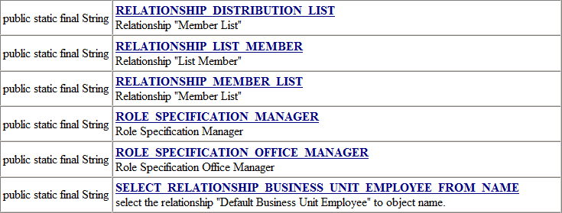
com.matrixone.apps.common Package (common.jar)
All Classes in com.matrixone.apps.common package, which represents the schema types, derived from DomainObject.
You can extend common class with each type methods and string constants with admin names and selectable(s).

Slide 37
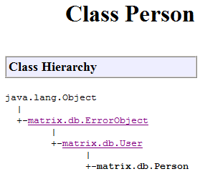

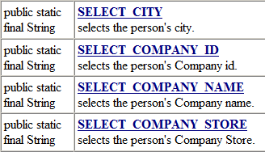
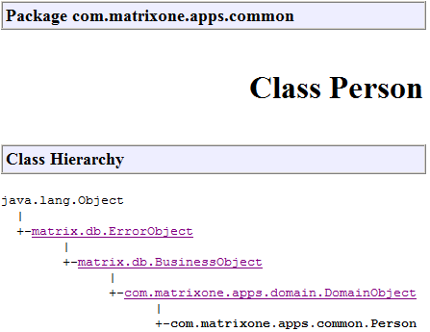
Person Class
There are two classes for working with Persons:
matrix.db.Person – represents Administrative Person object.
com.matrixone.apps.common.Person – represents Business object of type Person.

Slide 38
Nesting of Transactions
Transactions cannot be nested.
If the start of transaction method is called a second time before the commit or abort methods are called for the first transaction, the system throws a MatrixException.
Before starting a transaction, use the isTransactionActive() method to determine if a transaction is still active. If the result is false, it’s safe to start another transaction. If true, you must abort or commit the active transaction before starting a new one.

Slide 39
Studio Customization Toolkit Programming Notes (1/2)
Using getPersons():
Storing data in a HttpSession or static member variables of a JSP requires some consideration and careful planning
For example, a page may display a list of users in a select field. The list of users is retrieved with the matrix.db.Person.getPersons() method every time the page is displayed
If the installation has a lot users, a large number of objects will be created that only exist for a short period of time and put a strain on the Java garbage collection
A better solution is to retrieve the list once, keep it in a static member variable, and refresh it every 24 hours.

Slide 40
Studio Customization Toolkit Programming Notes (2/2)
Using a Range Program:
The same concepts for retrieving a list of users apply for user-specific data.
The values of an attribute range may be determined by a range program and made dependent on the actual user
Recalculating these values whenever these values are displayed is costly
The better solution is to determine the values once and then store them in the HttpSession object
While there are many cases where this caching technique may be beneficial for performance and scalability, one needs to be careful not to create a memory leak by mistake

